Slide 1

Modeling and Validation of Reflecting Metasurfaces for Improved mmWave Coverage
Master Thesis $1^{st}$ Interim Presentation
Padmashree Reddy
Supervisor: Simon Häger
11.10.2023

Slide 2
Outline
Motivation
Methodology and Implementation
Results and Conclusion
Timeline and Next Steps

Slide 3


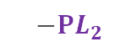



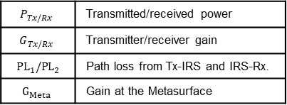





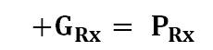
Potential of mmWave Communication
$$P_{Tx/Rx}$$ | Transmitted/received power
$$G_{Tx/Rx}$$ | Transmitter/receiver gain
$${ PL}_{1}/{PL}_{2}$$ | Path loss from Tx-IRS and IRS-Rx.
$$G_{Meta}$$ | Gain at the Metasurface
Metasurfaces deployment in mmWave Communication
Buildings with metasurface
Communication link with metasurfaces
$$P_{Tx}+G_{Tx}$$
$$−{PL}_{1}$$
$$+G_{Meta}$$
$$−{PL}_{2}$$
$$+G_{Rx}= P_{Rx}$$
Advantages:
Higher bandwidth and data rates
Network capacity extension
Disadvantages:
Higher path loss
Susceptibility to blockage
Beam management
$${PL}_{1}$$
BS
$${PL}_{2}$$
$$PL$$
P3
P1
Typical communication link
LOS
NLOS
VLOS
P2
$$P_{Tx}+G_{Tx}− PL+G_{Rx}= P_{Rx}$$
$$PL$$

Slide 4
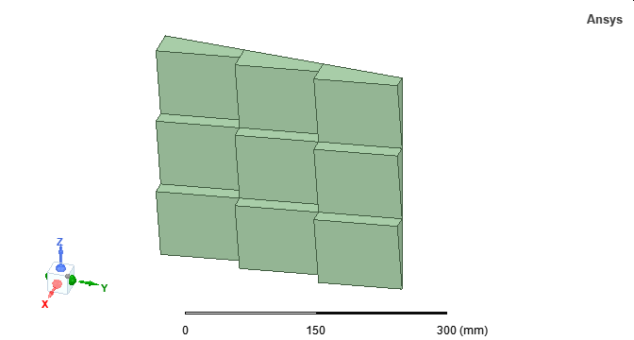
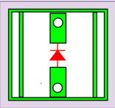


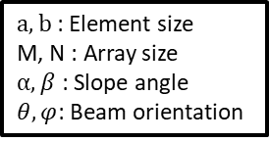

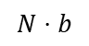

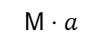
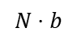

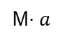
Deployment of Passive and Active Metasurfaces
HELIOS Reflectors
Intelligent Reflecting Surfaces
Control board
Copper plate
Array of active elements
$$N⋅b$$
Array of passive elements
$$N⋅b$$
$$\text{M}⋅a$$
Transmitted wave$(θ,φ)$
Transmitted wave$(θ,φ)$
M$⋅a$
Reflected wave $(θ,φ)$
Reflected wave $(θ,φ)$
Advantages:
Enhanced signal coverage and quality
Flexibility and adaptability
Disadvantages:
Synchronization and coordination
Complexity and cost
Additional Advantages:
Low power consumption
Easy integration and cost-effective
Disadvantages:
Limited control
Lack of reflection pattern adaptation in real-time
Building with metasurface
Need to optimize the deployment of HELIOS reflectors and improve performance gain.
$a,b$: Element size
M, N : Array size
$α, β$ : Slope angle
$θ,φ$: Beam orientation
Motivates network planning!

Slide 5


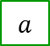
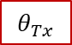
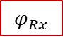
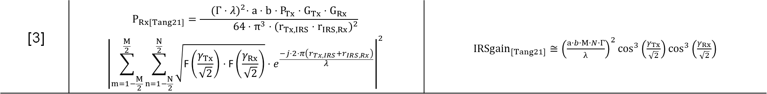



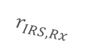
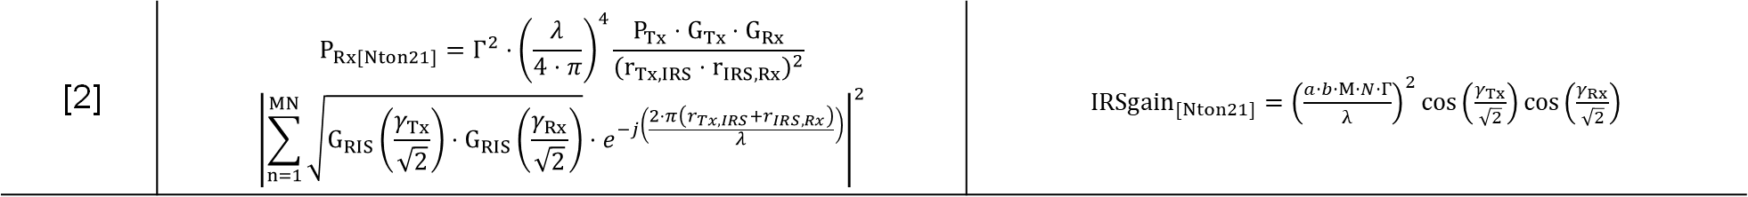
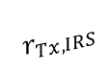

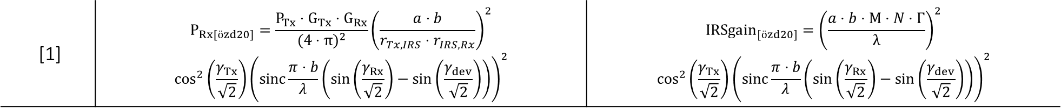


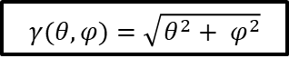
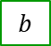

Existing Model Extension
$$Reflector$$
$$γ(θ,φ)=\sqrt{θ^{2}+ φ^{2}}$$
Tx
Rx
$$r_{Tx,IRS}$$
$$r_{IRS,Rx}$$
Models | Modified Power Received Formula | Gain at the Reflector
[1] | $$P_{Rx[özd20]}=\frac{P_{Tx}⋅G_{Tx}⋅G_{Rx}}{{(4⋅π)}^{2}}{\left(\frac{a⋅b}{r_{Tx,IRS}⋅r_{IRS,Rx}}\right)}^{2}$$ $$\cos^{2}\left(\frac{γ_{Tx}}{\sqrt{2}}\right){\left(sinc⁡\frac{π⋅b}{λ}\left(\sin\left(\frac{γ_{Rx}}{\sqrt{2}}\right)−\sin\left(\frac{γ_{dev}}{\sqrt{2}}\right)\right)\right)}^{2}$$ | $${IRSgain}_{[özd20]}={\left(\frac{a⋅b⋅M⋅N⋅Γ}{λ}\right)}^{2}$$ $$\cos^{2}\left(\frac{γ_{Tx}}{\sqrt{2}}\right){\left(sinc⁡\frac{π⋅b}{λ}\left(\sin\left(\frac{γ_{Rx}}{\sqrt{2}}\right)−\sin\left(\frac{γ_{dev}}{\sqrt{2}}\right)\right)\right)}^{2}$$
$$a$$
$$b$$
$$M$$
$$N$$
$$λ$$
$$Γ$$
Similarities
[2] | $$P_{Rx[Nton21]}={Γ^{2}⋅\left(\frac{λ}{4⋅π}\right)}^{4}\frac{P_{Tx}⋅G_{Tx}⋅G_{Rx}}{{(r_{Tx,IRS}⋅r_{IRS,Rx})}^{2}}$$ $${\left|\sum_{n=1}^{MN}{\sqrt{G_{RIS}\left(\frac{γ_{Tx}}{\sqrt{2}}\right)⋅G_{RIS}\left(\frac{γ_{Rx}}{\sqrt{2}}\right)}⋅e^{−j\left(\frac{2⋅π\left(r_{Tx,IRS}+r_{IRS,Rx}\right)}{λ}\right)}}\right|}^{2}$$ | ${IRSgain}_{[Nton21]}={\left(\frac{a⋅b⋅M⋅N⋅Γ}{λ}\right)}^{2}cos\left(\frac{γ_{Tx}}{\sqrt{2}}\right)cos\left(\frac{γ_{Rx}}{\sqrt{2}}\right)$
Differences
[3] | $$P_{Rx[Tang21]}=\frac{{(Γ⋅λ)}^{2}⋅a⋅b⋅P_{Tx}⋅G_{Tx}⋅G_{Rx}}{ 64⋅π^{3}⋅{(r_{Tx,IRS}⋅r_{IRS,Rx})}^{2}}$$ $${\left|\sum_{m=1−\frac{M}{2}}^{\frac{M}{2}}{\sum_{n=1−\frac{N}{2}}^{\frac{N}{2}}{\sqrt{\text{F}\left(\frac{γ_{Tx}}{\sqrt{2}}\right)⋅\text{F}\left(\frac{γ_{Rx}}{\sqrt{2}}\right)}}}⋅e^{\frac{−j⋅2⋅π\left(r_{Tx,IRS}+r_{IRS,Rx}\right)}{λ}}\right|}^{2}$$ | ${IRSgain}_{[Tang21]}≅{\left(\frac{a⋅b⋅M⋅N⋅Γ}{λ}\right)}^{2}\cos^{3}\left(\frac{γ_{Tx}}{\sqrt{2}}\right)\cos^{3}\left(\frac{γ_{Rx}}{\sqrt{2}}\right)$
$$θ_{Tx}$$
$$φ_{Tx}$$
$$θ_{Rx}$$
$$φ_{Rx}$$
[1] Ö. Özdogan, E. Björnson and E. G. Larsson, "Intelligent Reflecting Surfaces: Physics, Propagation, and Pathloss Modeling," in IEEE Wireless Communications Letters, vol. 9, no. 5, May 2020.
[2] K. Ntontin et al., "Optimal Reconfigurable Intelligent Surface Placement in Millimeter-Wave Communications," European Conference on Antennas and Propagation (EuCAP), March 2021.
[3] W. Tang et al., "Wireless Communications With RIS: Path Loss Modeling and Experimental Measurement," in IEEE Transactions on Wireless Communications, vol. 20, no. 1, Jan. 2021

Slide 6
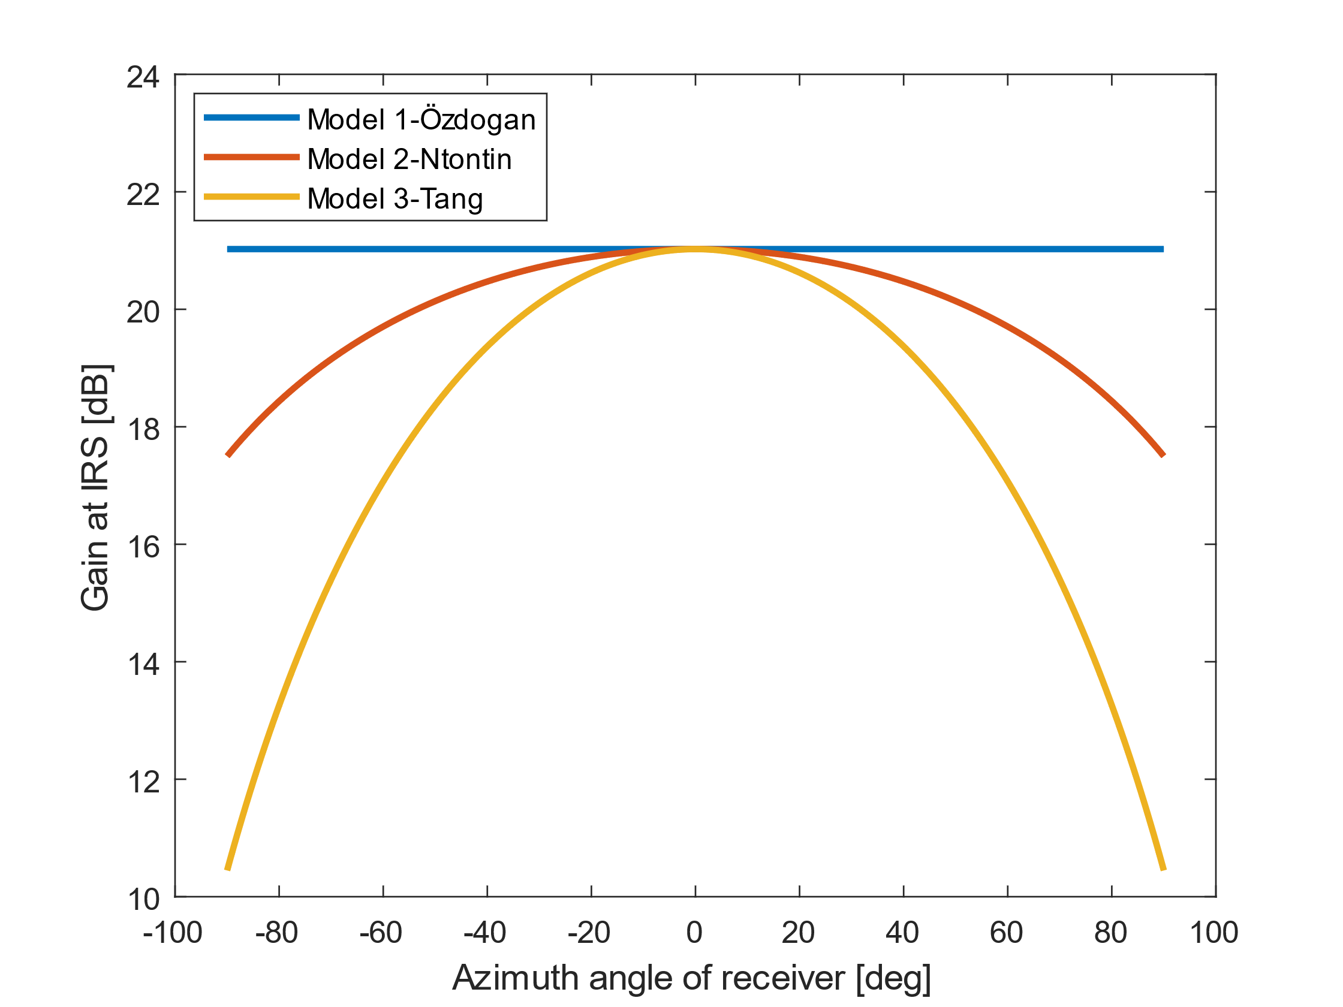
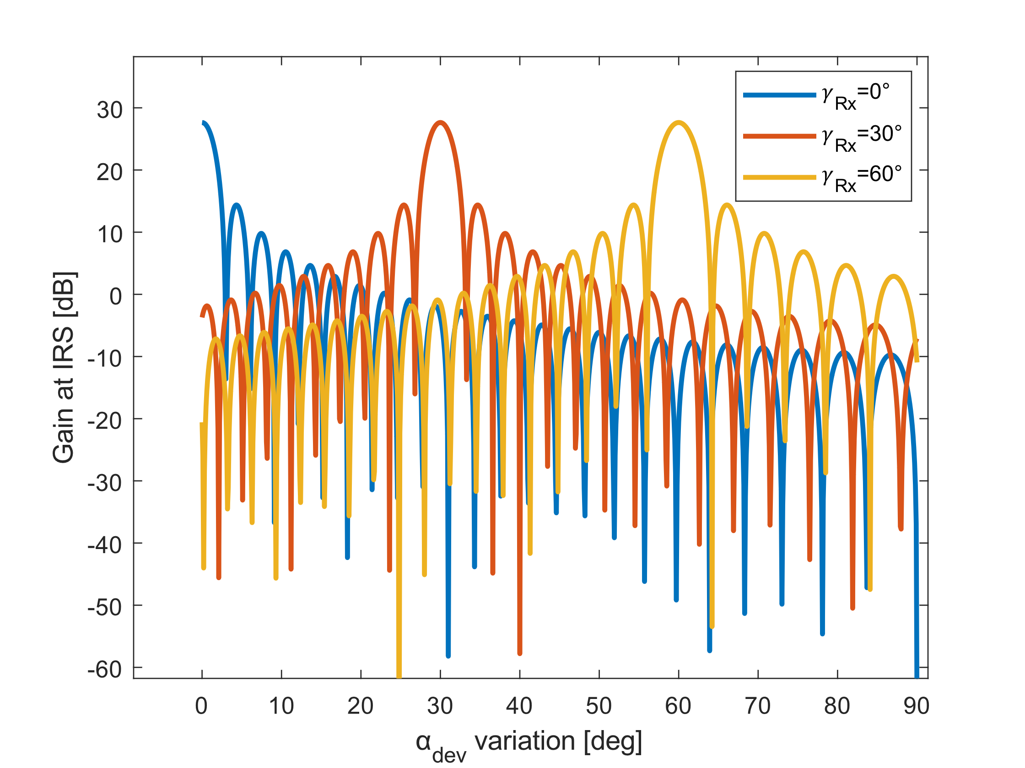
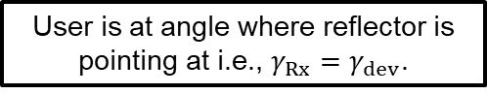
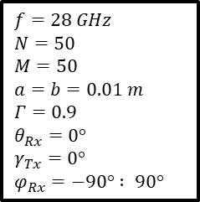

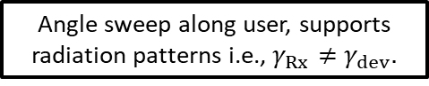
Comparison of IRS Models
$$f=28 GHz$$
$$N=50$$
$$M=50$$
$$a=b=0.01 m$$
$$Γ=0.9$$
$$θ_{Rx}=0°$$
$$γ_{Tx}=0°$$
$$φ_{Rx}=−90° : 90°$$
Maximum gain when Tx/Rx orthogonal to the reflector surface.
User is at angle where reflector is pointing at i.e., $γ_{Rx}=γ_{dev}$.
IRSgain [dB]
IRSgain [dB]
Loss of gain when reflector focuses away from surface normal.
0
$γ_{dev}$ variation [deg]
Angle sweep along user, supports radiation patterns i.e., $γ_{Rx}≠γ_{dev}.$

Slide 7
Conceptualizing Reflection Model for HELIOS

Slide 8
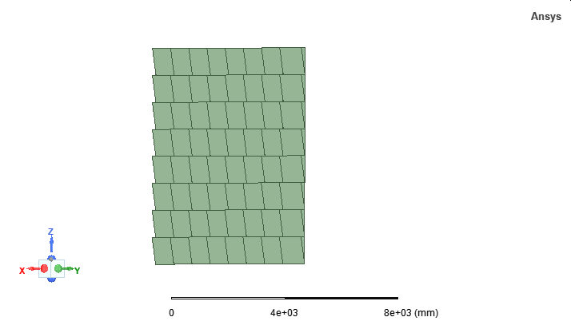
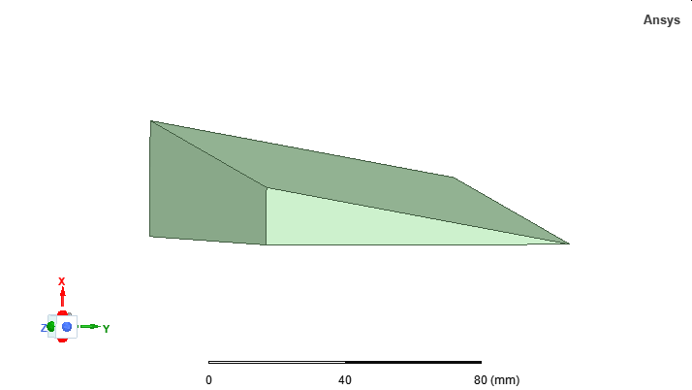
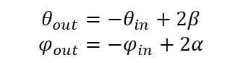
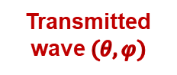
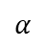
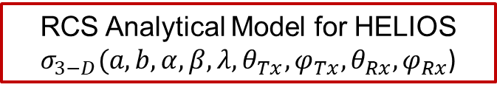
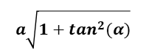
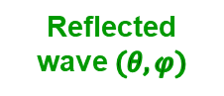
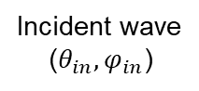
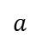

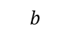
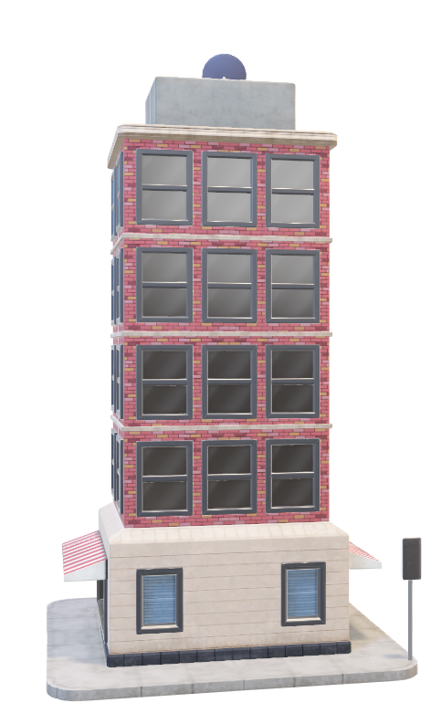

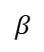
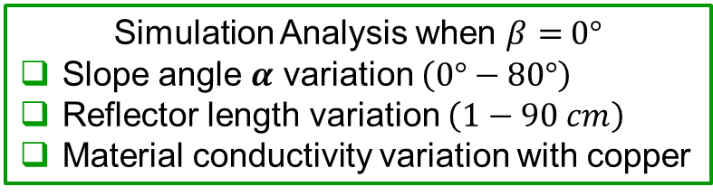
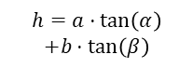
2. HELIOS Module Concept [4]
$a,b$: Element size
M, N : Array size
$α, β$ : Slope angle
$θ,φ$: Beam orientation
(Previous)
Simulation Analysis when $β=$ $0°$
Slope angle $α$ variation $\left(0°−80°\right)$
Reflector length variation $\left(1−90 cm\right)$
Material conductivity variation with copper
b$\sqrt{1+\tan^{2}(β)}$
Reflecting
surface
Incident wave
(${θ_{in},φ}_{in}$)
$$a\sqrt{1+\tan^{2}(α)}$$
$$θ_{out}=−θ_{in}+2β$$
$$φ_{out}=−φ_{in}+2α$$
(Begun)
Wall
surface
normal
Reflector
Surface
Normal
RCS Analytical Model for flat plate $σ_{RCS}({a,b,λ, θ}_{Tx}, θ_{Rx},φ_{Rx}$)
(Aim)
X
RCS Analytical Model for HELIOS $σ_{3−D}({a,b,α, β, λ, θ}_{Tx},φ_{Tx},θ_{Rx},φ_{Rx}$)
$$β$$
Z
Reflected wave $(θ,φ)$
$$h=a⋅\tan\left(α\right)$$
$$+b⋅\tan\left(β\right)$$
Y
Transmitted wave $(θ,φ)$
$$α$$
$$b$$
$$a$$
[4] S. Häger, K. Heimann, S. Böcker and C. Wietfeld, "Holistic Enlightening of Blackspots With Passive Tailorable Reflecting Surfaces for Efficient Urban mmWave Networks," in IEEE Access, vol. 11, 2023..

Slide 9
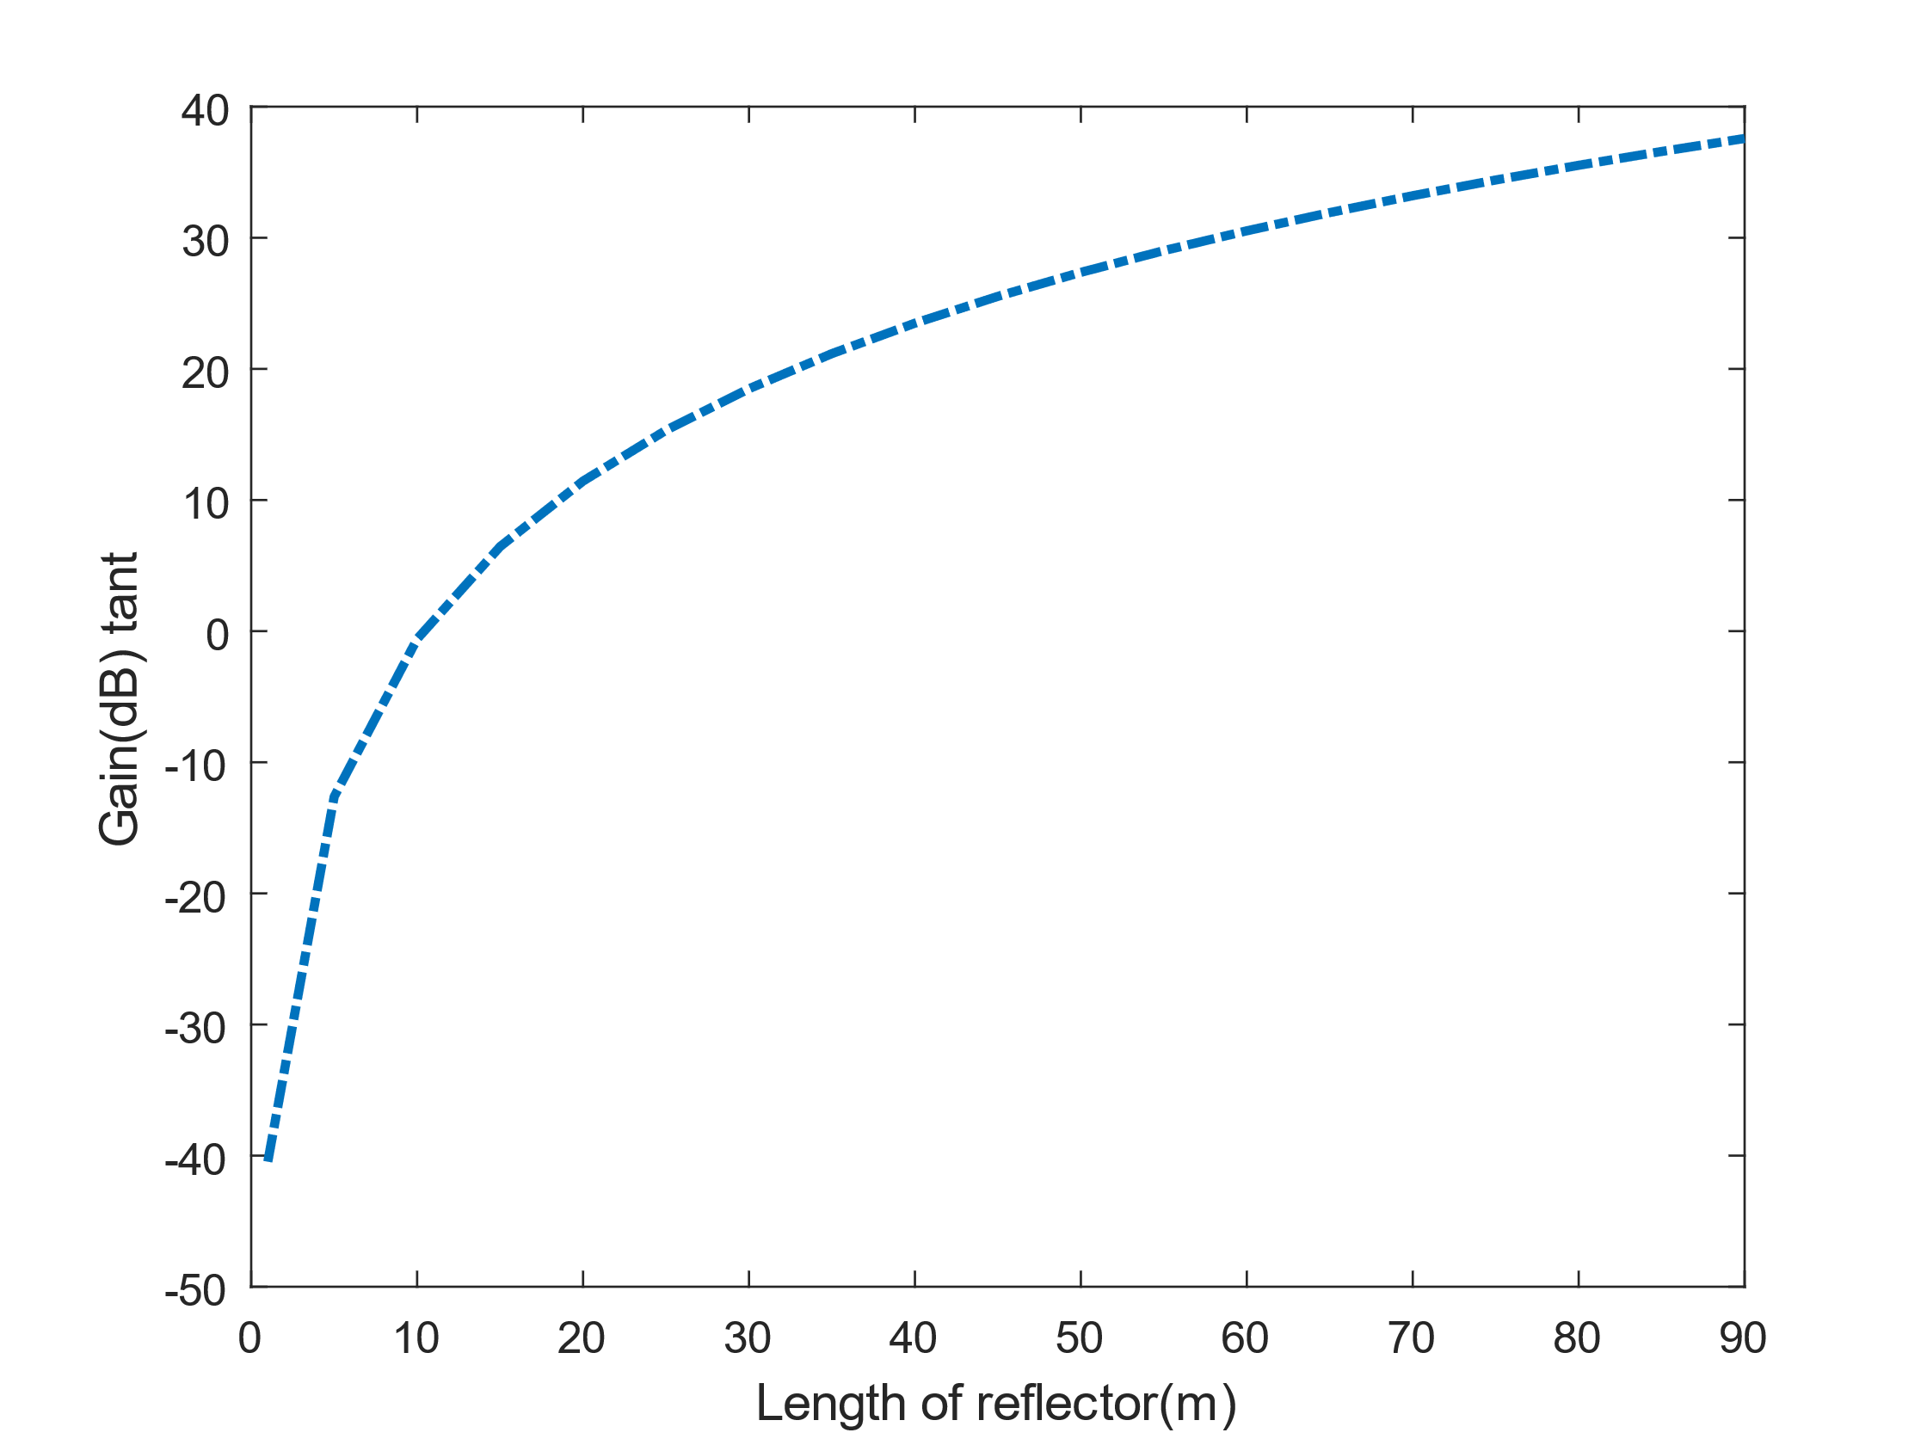
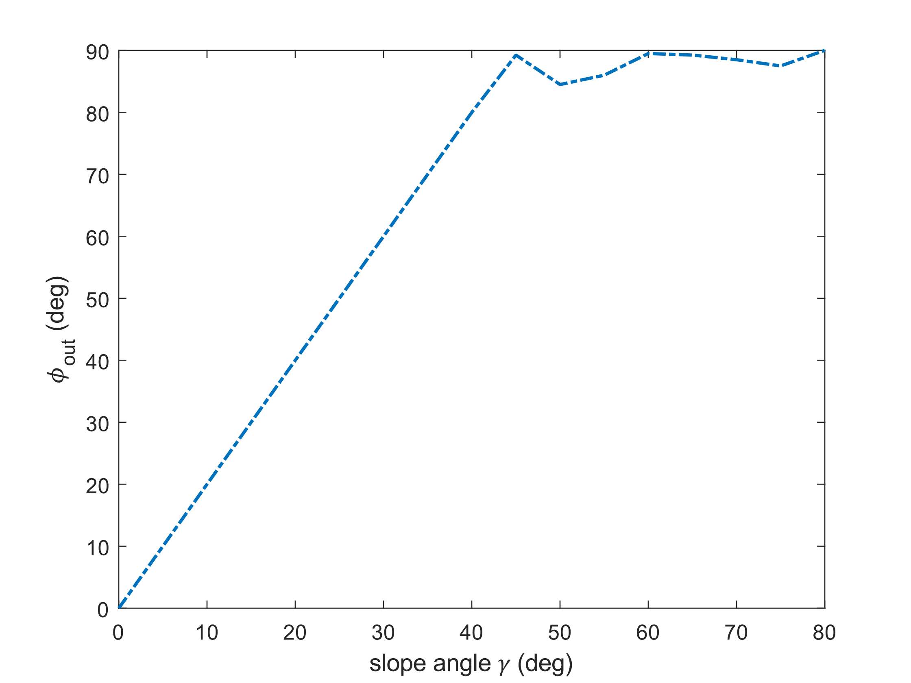
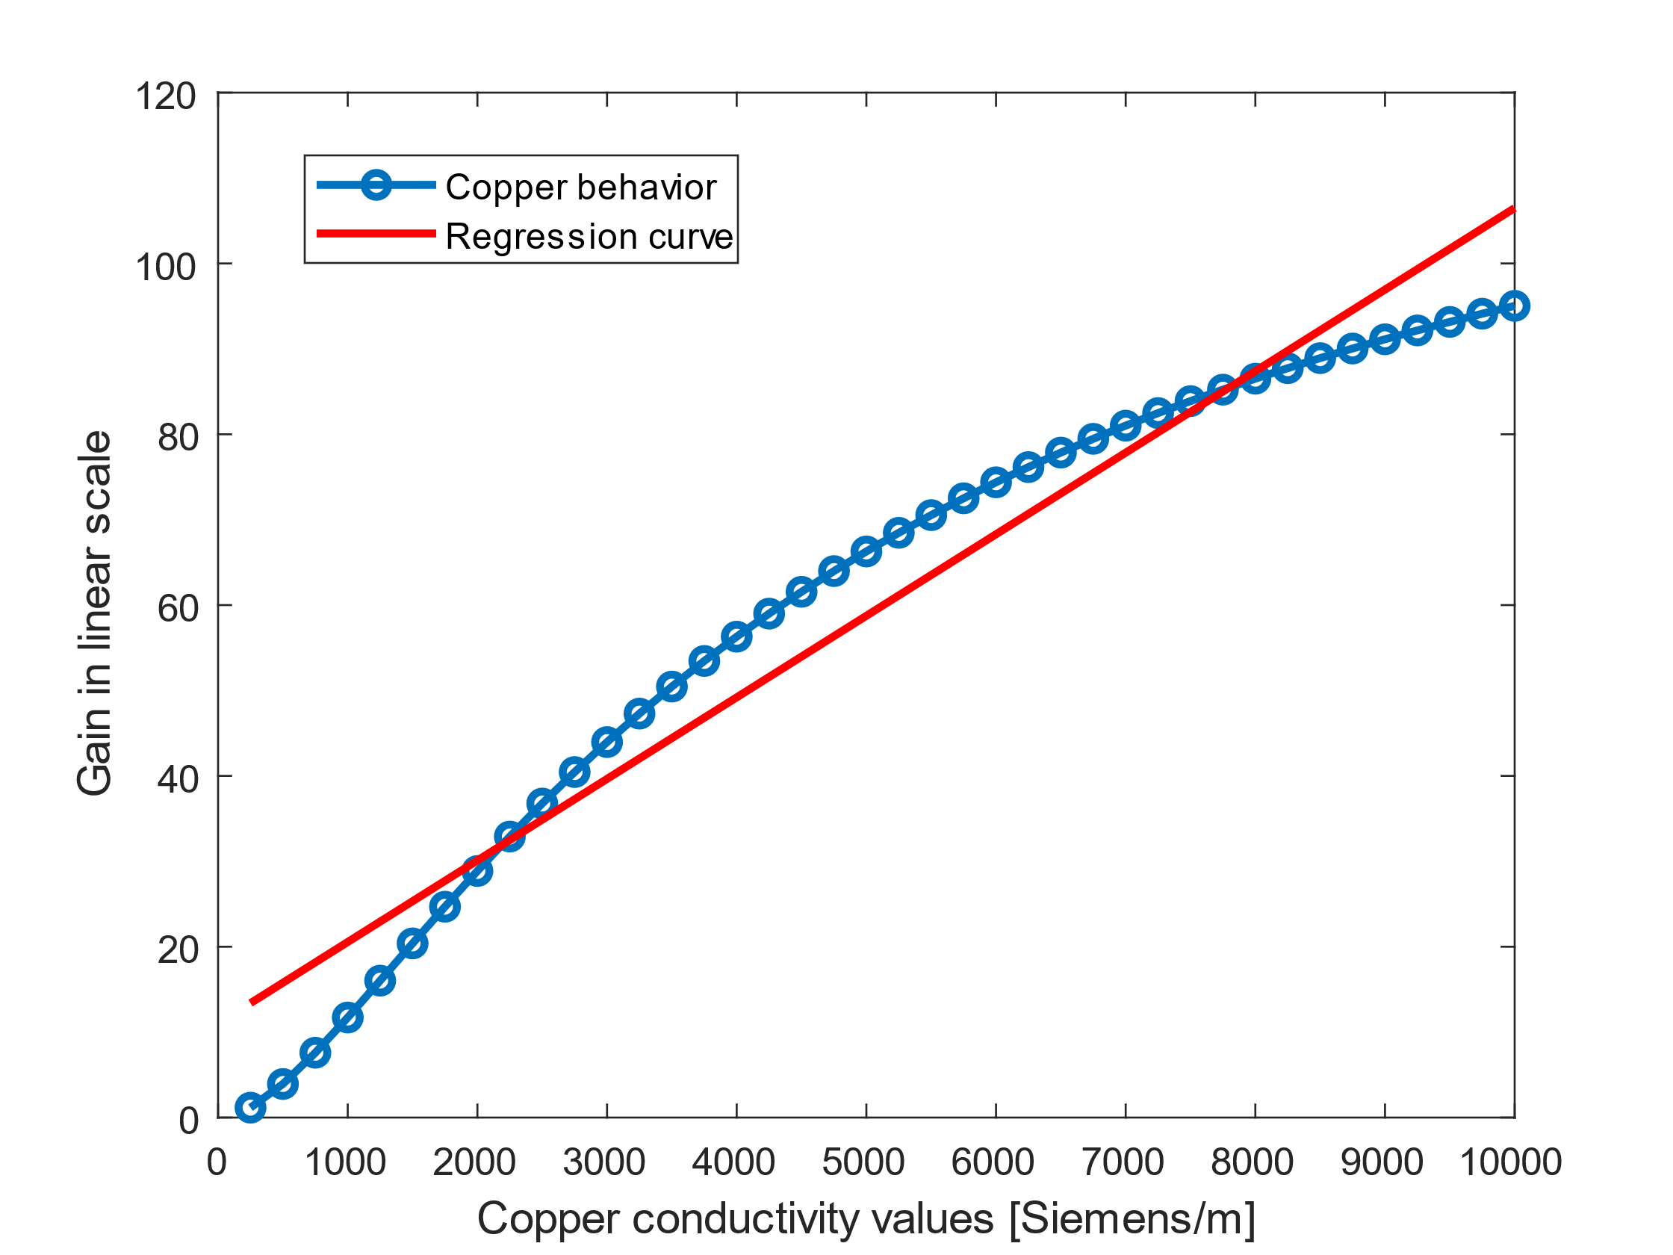
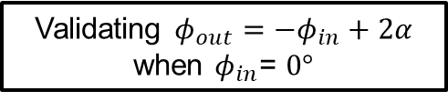


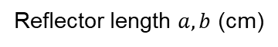
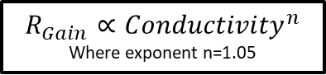
Simulated Results from HELIOS Module
Saturation as the main lobes is out-of-range of the considered far field
Gain (dB)
Gain (dB) linear scale
$$R_{Gain}∝{(a∙b) }^{2}$$
$$R_{Gain}∝{Conductivity}^{n}$$
Where exponent n=1.05
Reflector length $a, b$ (cm)
Slope angle $α$ (deg)
Copper conductivity values (Siemens/m)
Similar to IRS model [1-3]
Validating $φ_{out}=−φ_{in}+2α$
when $φ_{in}$= $0°$
Similar to IRS model [1-3]

Slide 10
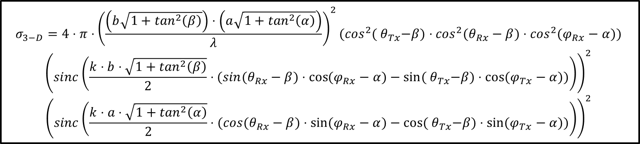
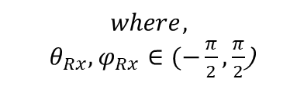
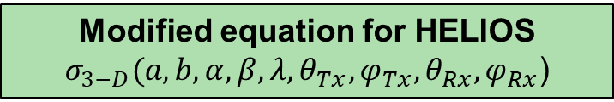
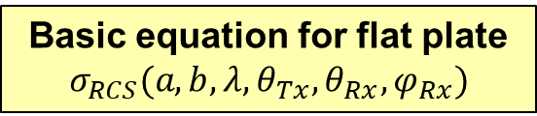
2. Analytical Modeling of HELIOS element: Bistatic Radar-Cross-Section (RCS)
Basic equation for flat plate
$$σ_{RCS}({a,b,λ, θ}_{Tx}, θ_{Rx},φ_{Rx})$$
Modified equation for HELIOS
$$σ_{3−D}({a,b,α, β, λ, θ}_{Tx},φ_{Tx},θ_{Rx},φ_{Rx}\text{)}$$
Aspects | Basic equation for flat plate $$σ_{RCS}({a,b,λ, θ}_{Tx}, θ_{Rx},φ_{Rx})$$ | Modified equation for HELIOS $σ_{3−D}({a,b,α, β, λ, θ}_{Tx},φ_{Tx},θ_{Rx},φ_{Rx}$)
[5-7]
Reflector Size | $$(a⋅b)$$ | $$\left(b\sqrt{1+\tan^{2}\left(β\right)}\right)⋅\left(a\sqrt{1+\tan^{2}\left(α\right)}\right)$$
Supported angles | $${ θ}_{Tx},θ_{Rx},φ_{Rx}$$ | $${ θ}_{Tx},φ_{Tx},θ_{Rx},φ_{Rx}$$
Rotation of reflecting surface |  | $${ θ}_{Tx}−β,φ_{Tx}−α,θ_{Rx}−β,φ_{Rx}−α$$
Beamwidth correction factor |  | 1/2
$$σ_{3−D}=4⋅π⋅{\left(\frac{\left(b\sqrt{1+\tan^{2}\left(β\right)}\right)⋅\left(a\sqrt{1+\tan^{2}\left(α\right)}\right)}{λ}\right)}^{2}{(cos}^{2}({ θ}_{Tx}−β)⋅\cos^{2}(θ_{Rx}−β)⋅\cos^{2}(φ_{Rx}−α))$$
$${\left(sinc\left(\frac{k⋅b⋅\sqrt{1+\tan^{2}\left(β\right)}}{2}⋅(sin(θ_{Rx}−β)⋅\cos{(φ_{Rx}−α)}−sin⁡({ θ}_{Tx}−β)⋅\cos{(φ_{Tx}−α)})\right)\right)}^{2}$$
$${\left(sinc\left(\frac{k⋅a⋅\sqrt{1+\tan^{2}\left(α\right)}}{2}⋅(cos(θ_{Rx}−β)⋅\sin{(φ_{Rx}−α)}−cos⁡({ θ}_{Tx}−β)⋅\sin{(φ_{Tx}−α}))\right)\right)}^{2}$$
$$where,$$
$θ_{Rx},φ_{Rx}∈(−\frac{π}{2},\frac{π}{2}$)
[5] C.A. Balanis, Advanced Engineering Electromagnetics. Ed. 2, Chapter 11, John Wiley & Sons, 2012.
[6] D. E. Kerr, Propagation of Slwrt Radio Waves, hl.1.T. Rad. Lab. Ser.,So. 13. Lexington, Mass.: Boston Tech. Pub., 1964.
[7] S. Häger, K. Heimann, S. Böcker, C. Wietfeld, "Holistic Enlightening of Blackspots with Passive Tailorable Reflecting Surfaces for Efficient Urban mmWave Networks," In IEEE Access, vol. 11.

Slide 11





3. Comparison of Analytical and Simulated values: Variation of Width
They both behave the same!
Behavior when $a=b$
Crossover when $a=b=10cm$ which is part of both the curves.
Behavior when $a=10cm$
Gain increases with reflector size.

Slide 12





3. Comparison plot of HELIOS Reflector Module
Simulated and analytical model match as desired!
Gain matches.
Beams get narrower as reflector size increases.
1st side lobe Matches.
2nd side lobe matches.
10
$$a=10cm, b=20cm$$
$$α=10°, β=5°$$
$φ_{in}$= $θ_{in}$=$0°$
$$φ_{out}=−φ_{in}+2α$$
$$θ_{out}=−θ_{in}+2β$$

Slide 13


3. Heatmap Comparison of Analytical and Simulations: HELIOS Reflector Element
Analytical Model
Simulations
This variation is a work in progress.
Side lobes match
Theta [deg]
Gain [dB]
Phi [deg]
$$a=b=10cm$$
$$α=β=10°$$
There are sufficient similarities between both.

Slide 14







3. Comparison of Analytical and Simulated values: Reflector Array [8]
$$a_{n,m}\text{=}b_{n,m}=10cm$$
$$α_{n,m}=β_{n,m}=10°$$
$${Gain}_{RCS} [dB]={\left( \sum_{n=1}^{N}{\sum_{m=1}^{M}{\sqrt{σ_{3D}\text{(}a_{m,n}\text{,}b_{m,n}\text{,}α_{m,n},β_{m,n}\text{)}}}} \right)}^{2}$$
Reflected wave $(θ,φ)$
1.22 dB
0.44 dB
Transmitted wave $(θ,φ)$
Shadowed
region
No self-shadowing
1xN array
MxN array
RCS doesn’t account for self-shadowing yet.
[8] M. I. Skolnik, "Radar Handbook," 3rd ed., New York, NY, USA: McGraw-Hill, 2008.

Slide 15



3. Heatmap Comparison of Varied Analytical and Simulated Values:
$$a_{n,m}\text{=}b_{n,m}=10cm$$
$$α_{n,m}=β_{n,m}=10°$$
2x2 HELIOS
4x4 HELIOS
8x8 HELIOS
30
25
20
15
10
5
0
Beams get narrower with higher gains.
Analytical Model
Side lobe beamwidth matches
Lot of similarities can be observed.
Gain [dB]
Theta [deg]
30
25
20
15
10
5
0
But
RCS model doesn’t account for diffractions, as the model is kept simple.
Simulations
0 10 20 30
0 10 20 30
0 10 20 30
Phi [deg]

Slide 16

















3. HELIOS Extension for Broader Beams
RCS Analytical Model for HELIOS $σ_{3−D}({a,b,α, β, λ, θ}_{Tx},φ_{Tx},θ_{Rx},φ_{Rx}$)
Reflection is broadened.
Beams get broader.
Reflection is narrow.
Long simulations using HFSS
Desired reflection can be achieved faster
Changes by $\text{delta}\text{/}\text{n}\text{°}$
$$α_{n,m}=β_{n,m}=10°$$
$α_{3,2}=α_{2,2}$+𝑑𝑒𝑙𝑡𝑎/𝑛°
$β_{3,2}=β_{2,2}$+𝑑𝑒𝑙𝑡𝑎/𝑛°
$$α_{3,3}=α_{1,3}\text{+}\text{delta}\text{/}\text{n}\text{°}$$
$$β_{3,3}=β_{1,3}\text{+}\text{delta}\text{/}\text{n}\text{°}$$
$$α_{3,1}=α_{2,1}\text{+}\text{delta}\text{/}\text{n}\text{°}$$
$$β_{3,1}=β_{2,1}\text{+}\text{delta}\text{/}\text{n}\text{°}$$
$α_{2,2}=α_{1,2}$+𝑑𝑒𝑙𝑡𝑎/𝑛°
$β_{2,2}=β_{1,2}$+𝑑𝑒𝑙𝑡𝑎/𝑛°
$α_{2,3}=α_{1,3}$+𝑑𝑒𝑙𝑡𝑎/𝑛°
$$β_{2,3}=β_{1,3}\text{+}\text{delta}\text{/}\text{n}\text{°}$$
$α_{2,1}=α_{1,1}$ +𝑑𝑒𝑙𝑡𝑎/𝑛°
$β_{2,1}=β_{1,1}$ $+\text{delta}\text{/}\text{n}\text{°}$
$$α_{1,2}=α_{1,1}+delta$$
$$β_{1,2}=β_{1,1}+delta$$
$$α_{1,3}=α_{1,2}+delta$$
$$β_{1,3}=β_{1,2}+delta$$
$$α_{1,1}=β_{1,1}=10°$$
Changes by delta

Slide 17

4. Timeline
Stage 1
Literature reading
Stage 2
Stage 3
Implementation, Reinterpretation of IRS models
Stage 4
Familiarization with a thesis template
Preparation of kickoff presentation
HELIOS simulation with Ansys HFSS
HELIOS array simulation and modeling
Working on thesis section 3
Preparation of the second presentation
Optimizing and evaluating HELIOS model according to design requirement
Working on thesis section 4
Preparation of the third presentation
Working on the thesis’s final section
Preparation of the final presentation
Radar Cross Section (RCS) for planar surface
Comparing analytical and Ansys simulation
Tuning of analytical model
$$\sim$$

Slide 18






4. Next Steps: Addressing Self-Shadowing
$η\%$ of the reflecting surface will be shadowed
Reflected wave $(θ,φ)$
Modified equation for HELIOS module
$$η\%$$
$${σ_{3−D}}^{∗}=σ_{3−D}(η⋅{a,η⋅b,α, β, λ, θ}_{Tx},φ_{Tx},θ_{Rx},φ_{Rx}\text{)}$$
Where $η$ is shadowing factor
Transmitted wave $(θ,φ)$
Shadowed Region
$$η\%$$
X
Optimized analytical model
Z
Y

Slide 19













4. Next Steps: Assessing Impact in Specific Scenarios
UMi: Urban Micro
UMa: Urban Macro
FSPL: Free Space Path Loss
Overall communication link:
$$P_{Tx}+G_{Tx}$$
$$−{PL}_{1}$$
$$+G_{Meta}$$
$$+G_{Rx}= P_{Rx}$$
$$−{PL}_{2}$$
Reflectors
$(x_{Ref},y_{Ref},z_{Ref}$)
$${Gain}_{RCS}=$$
$${\left(\sum_{n=1}^{N}{\sum_{m=1}^{M}{\sqrt{σ_{3D}\text{(}a_{n,m}\text{,}b_{n,m}\text{,}α_{n,m},β_{n,m}\text{)}}}}\right)}^{2}$$
NLOS
VLOS
$${PL}_{1}$$
$$r_{Ref,Rx}$$
$${PL}_{2}$$
$$r_{Tx,Ref}$$
IRS Models
Receiver Grid
$(x_{Rx},y_{Rx},z_{Rx}$)
LOS: FSPL, 3GPP UMi and UMa scenarios
Transmitter
$(x_{Tx},y_{Tx},z_{Tx}$)

Slide 20
Thank you!

